Slide 1
Integration New Homepage
July 2016
By Boontaetae, Pongpayak
Notes:
Hi everyone. In my presentation today I would like to talk about Integration New Homepage

Slide 2
Agenda
Introduction
Current Problems of Integration Website
Goal & Design Concept
Web Statistics
Mockups Design
Feedbacks
Timeline
Notes:
And the Agenda I will be talk in my presentation are Introduce my self, What are pain points in current integration site, Goal & Design Concept in new site, Web Statistic from users clicked, new page Mockups Design, Feedback and Timeline

Slide 3
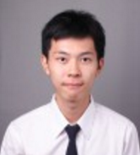
Introduction
Name: Pongpayak Boontaetae
Nickname: Nus
Education: 3rd year Computer Engineering, KMITL
Scope during internship
Improve Integration Team Site based on UCD
Research SAP change management process and identify areas for alignment
Expectations
Opportunity to experience SAP application in large firms
Interests: Data mining, Artificial Intelligence, Embedded System
Notes:
So, First let’s start with introducing myself. My name is Pongpayak Boontaetae. I’m 3rd year Computer Engineering student. My scope during internship are …. And …

Slide 4
Current Problems of Integration Website
Feedback received from UCD sessions done by Pongvud
Bad User Interface
Bad layout – bad menu arrangement
Spending many clicks to get what they need
Difficult to find the documents
Search Engine not effective
Redundant information
Contain outdated information
Notes:
OK, Next I’m going to talk about current team site pain points. These are feedbacks received from UCD.

Slide 5
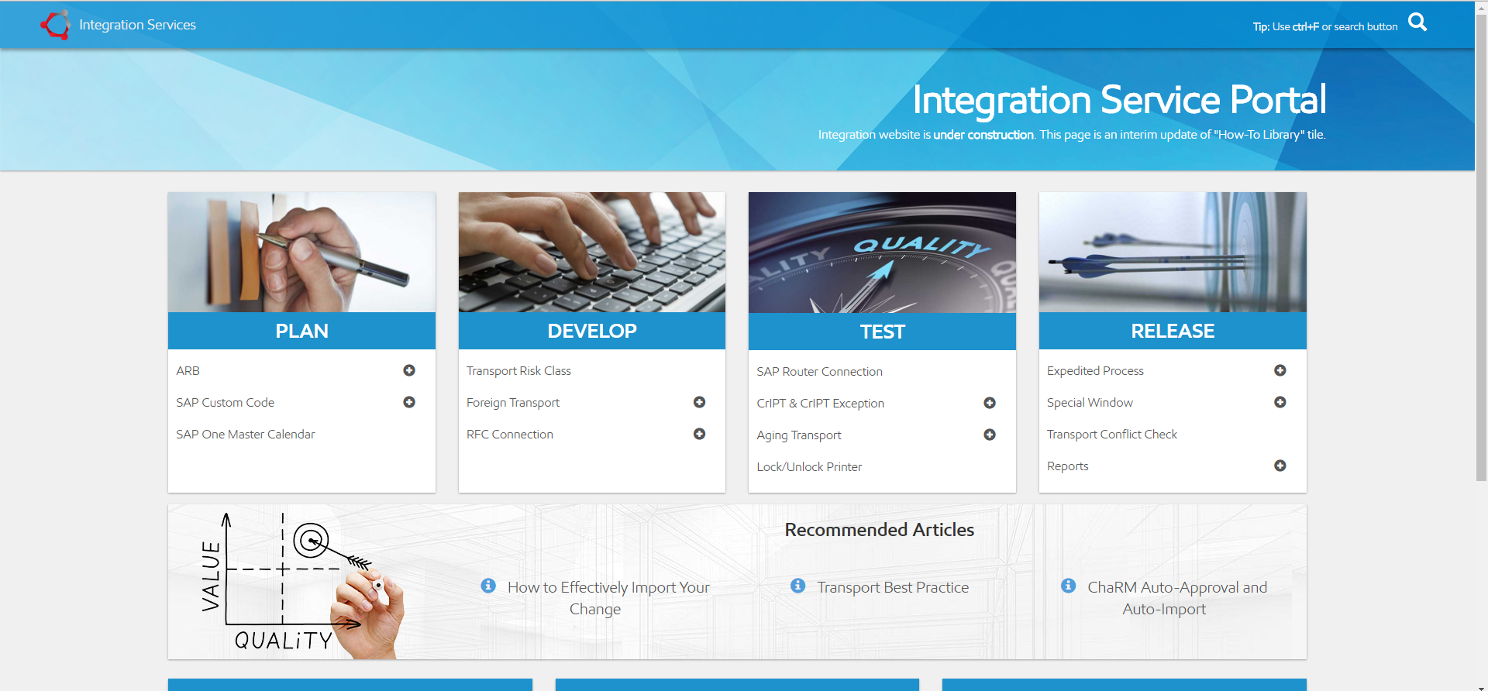
Goal & Design Concept
Goal
Improve the user interface (by Nus)
Improve document search engine (by Nus)
Correct content information & clean up documents (by Nan)
Design Concept
Simple design (clean and clear)
Portal page (One stop - All main functions in the main page)
Easy to search documents
Design Input
Integration Service Portal Page
Integration Web Click Statistics
Notes:
Next, Goal & Design Concept. The Goal are 3 important things. First to Improve the user interface for ease of use. Second to improve document search and third to correct content information and clean up documents.
New site Design concept I need it to be a simple page that easy to find information easy to search document and spend a few click to access the information

Slide 6
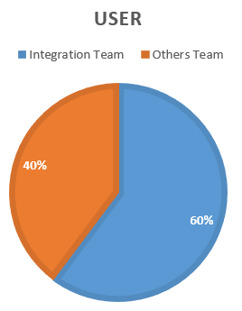
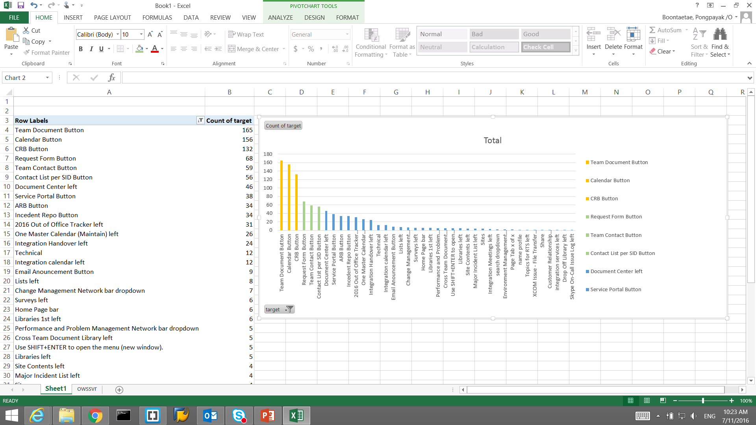
Web Statistics – People Clicked
2 web pages have been enabled to record the clicks (Home and Request Form)
Top Clicks: Team Document Button, SAP Calendar, CRB Repository
60% is Integration users
* From 16 Jun – 11 Jul
Notes:
Web statistic. As you can see the graph, the column chart is show about what user clicked in current homepage and the 3 most clicked are Team Documentation, SAP Calendar and CRB Repository. The pie chart is show about who is the user in our site and the result is 58 percent is integration team.
What does I do about this statistic. I use it to analyze where should menu be. It like put the right menu on the right position.

Slide 7
Web Statistics – People Never Clicked
Discussions
SAP Certification
SAP Custom Code Management
One SAP Meeting
Blog

Slide 8
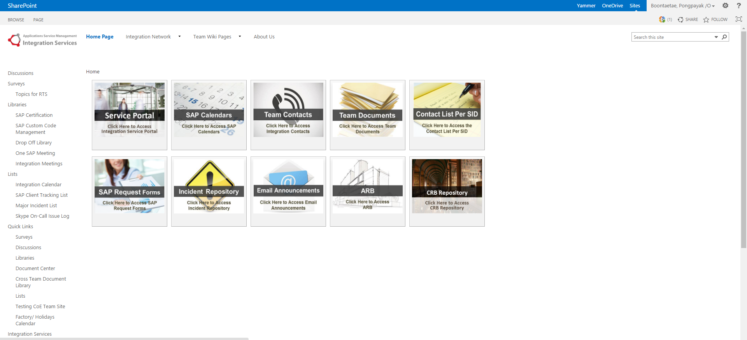
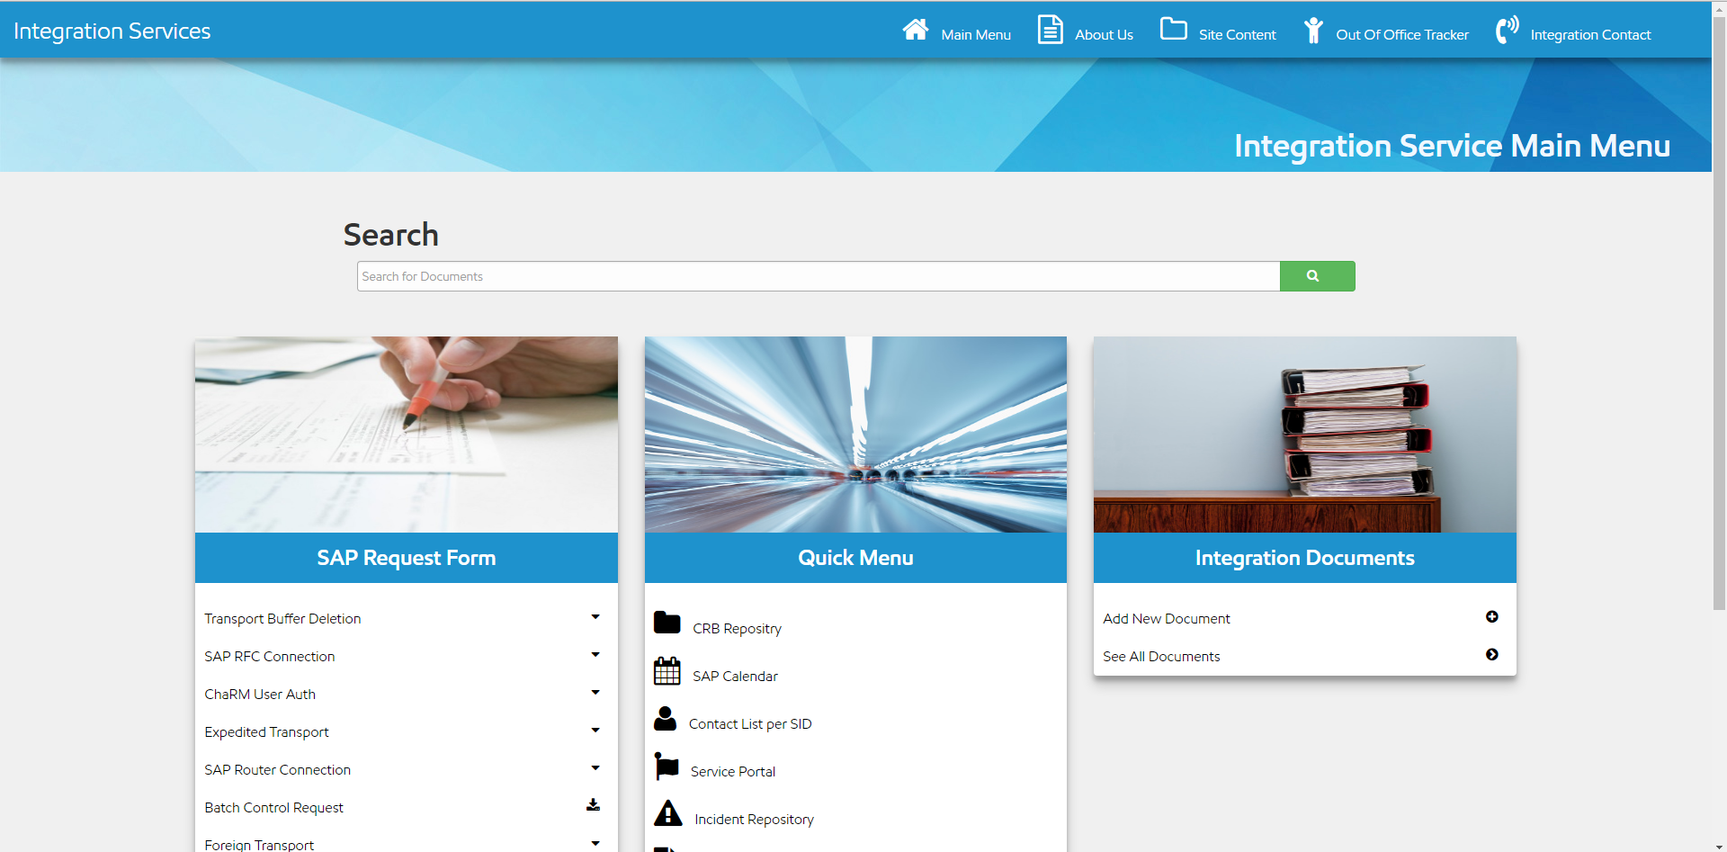
New Home Page
URL: https://ishareteam3.na.xom.com/sites/SASInt/intpro/index.html
Notes:
Aligned with Service Portal theme
Take web stat into consideration and frequent used buttons are placed
SAP form – sequence by most frequently used
Quick links – other frequently used by users
Team Documents – easy for Integration members to upload documents at home page

Slide 9
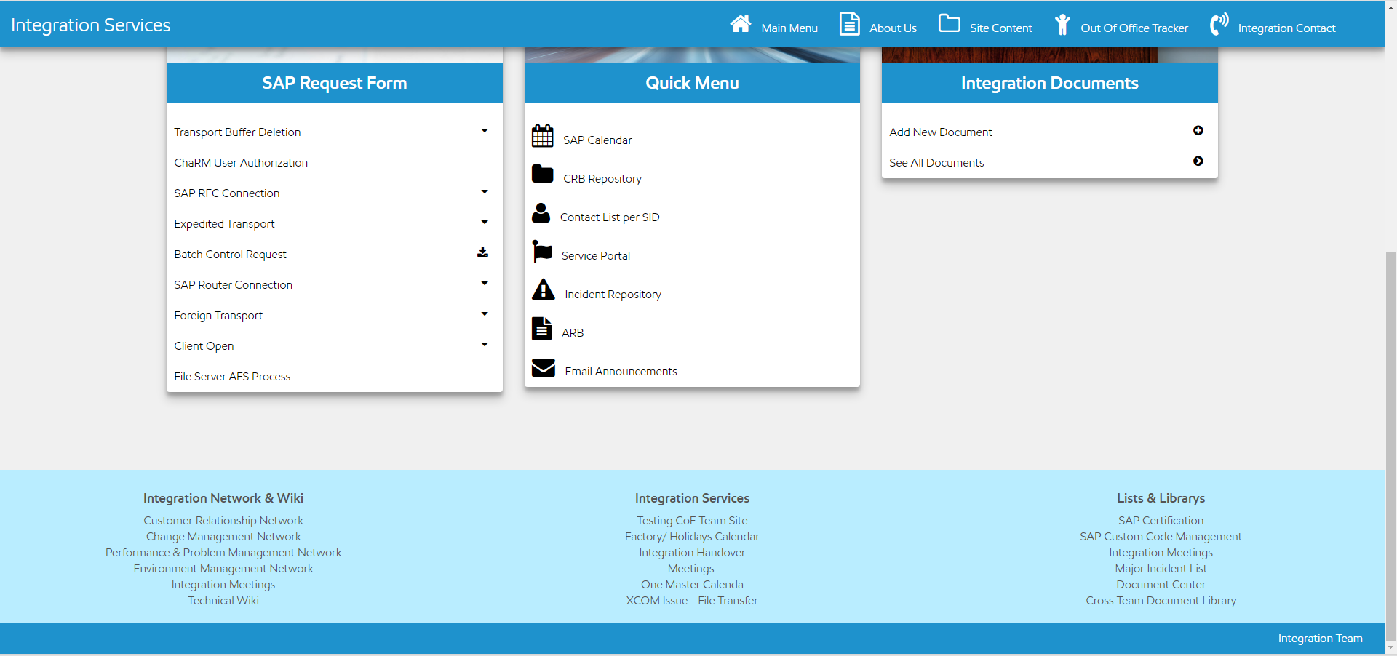
New Home Page
Current Position
May remove
New Position
Notes:
Aligned with Service Portal theme
Take web stat into consideration and frequent used buttons are placed
SAP form – sequence by most frequently used
Quick links – other frequently used by users
Team Documents – easy for Integration members to upload documents at home page

Slide 10
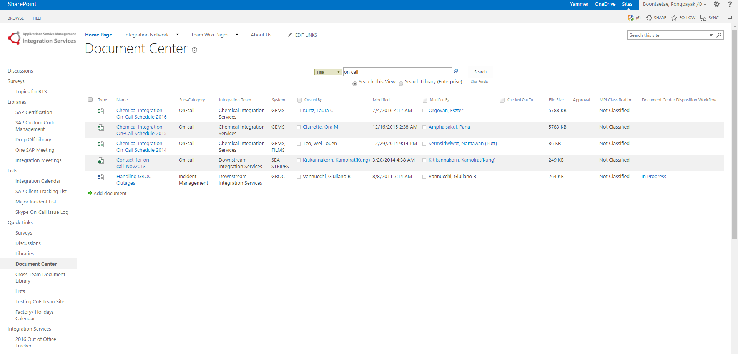
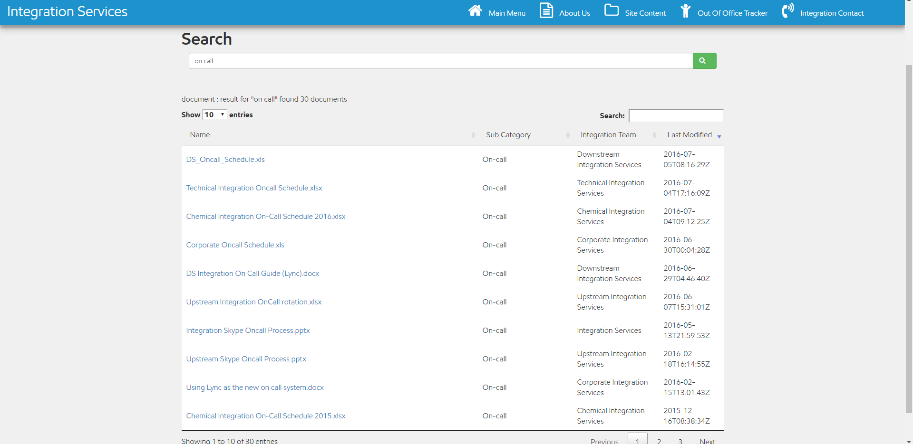
Improve Document Search

Slide 11
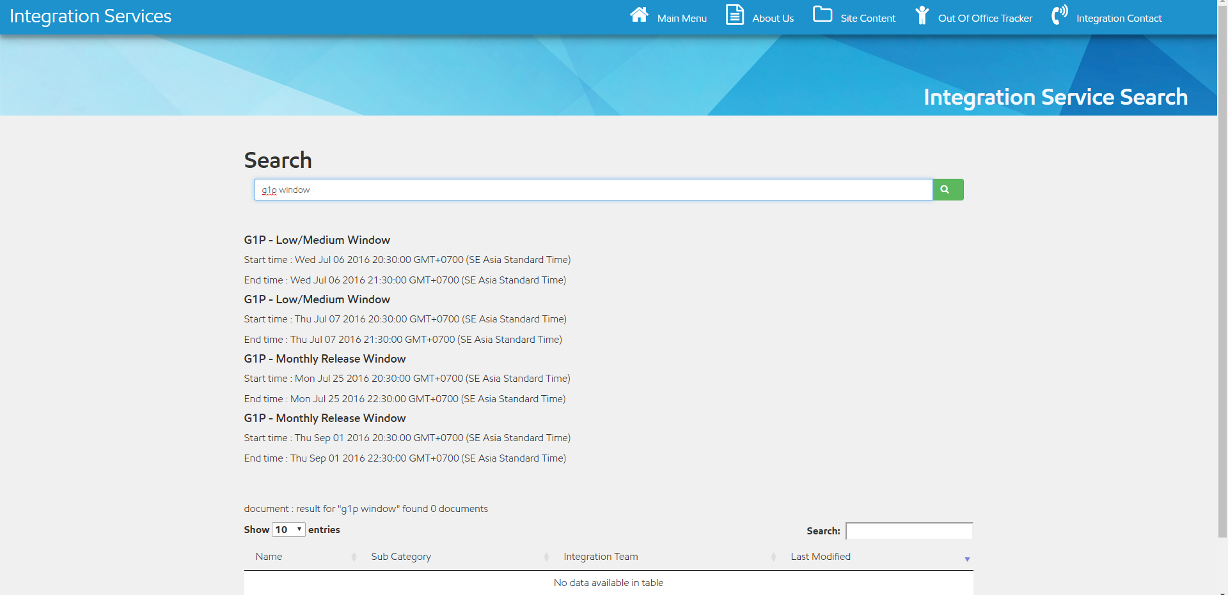
New Transport Window Search
Put in new Search function, utilizing same Search field for document search
Use simply keyword “[SID] Window” i.e. G1P window and function will display next available transport windows
Data is retrieved from the same input used for SAP One Master Calendar, no extra maintenance
* Not final version
Notes:
Develop search engine to provide most frequent questions to users
Provide next available transport windows (2 low/med & 2 monthly) by input simple text – SID + window
The data is retrieved from the same input used for SAP One Master Calendar

Slide 12
Feedbacks!
Feedback survey for new website will be sent to all Integration staff – Jul 20 2016
Require supervisors to assist following:
encourage your staff to respond
Forward the survey to your process team contact

Slide 13
Timeline
Completed
Pain Point
Web Statistic Collection
Mockups Design
Next Step
Gather Feedbacks from Integration Team – Jul 20 2016
Gather Feedbacks from Process Team – Jul 20 2016
Recycle per Comment – Jul 26 2016
Next Presentation to Leadership Team – Aug 19 2016
Launch New Webpage - Sep 1 2016
Notes:
Timeline, The things that completed is explore web pain points from user, web statistic collection (actually I still collect it until recycle) and made mockups as you saw it before. So, the next step I will do are gather feed back from Integration and process team after that I will recycle per each comment and then present the final version to all of you again and launch it on Aug 30.

Slide 14
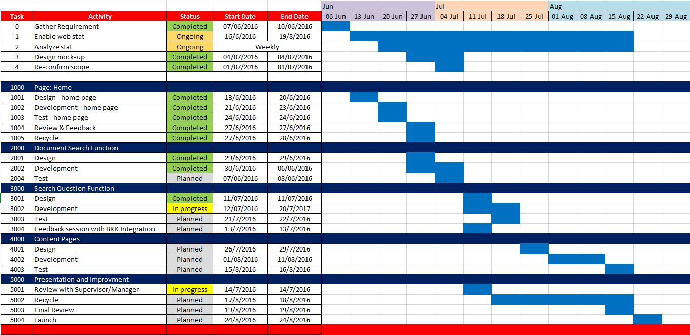
Timeline
Enabled web stat to collect clicks, data is analyzed on weekly basis
Home page site development has been completed and ready for review
Improved functions are being developed & under unit testing phase, session to get feedback from Bangkok team has been planned
Plan to publish new site by end of Aug, included recycle with other Integration members
Notes:
Study requirement for the first few weeks?
Decided to enable web trends to capture the data – when?
Plan for internal feedback

Slide 15
Notes:
Ok, any question?

Slide 16
References

Slide 17
References
Task Schedule - https://mysite.na.xom.com/personal/ap_pboonta/_layouts/15/WopiFrame2.aspx?sourcedoc=/personal/ap_pboonta/Documents/Shared%20with%20Everyone/task%20schedule.xlsx&action=default
New Homepage - https://ishareteam3.na.xom.com/sites/SASInt/intpro/index.html
Home page Statistic - https://ishareteam3.na.xom.com/sites/SASInt/Lists/Web%20stat%20Homepage/AllItems.aspx
Form Request Statistic - https://ishareteam3.na.xom.com/sites/SASInt/Lists/Web%20stat%20Form%20Requests/AllItems.aspx

